Slide 1
Waveguide-QED in the Squeezed Vacuum

Slide 2
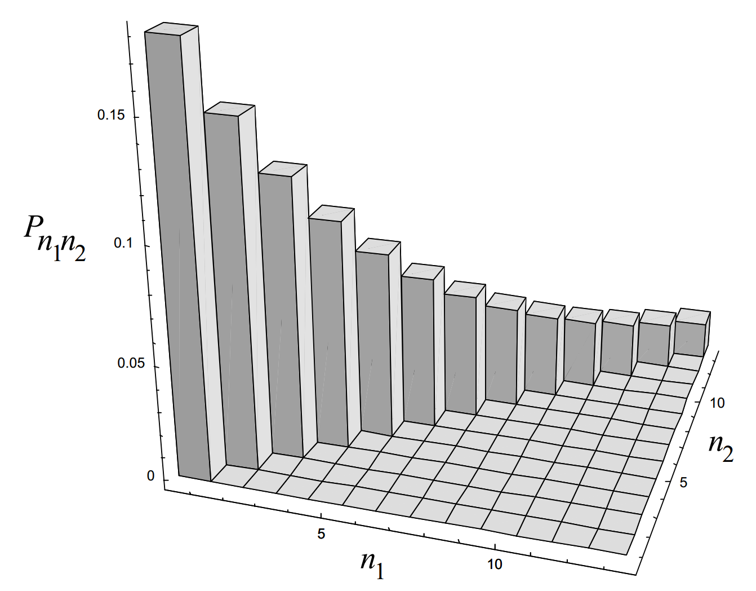
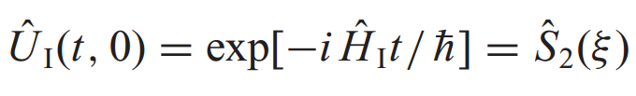
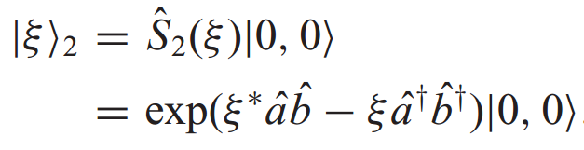
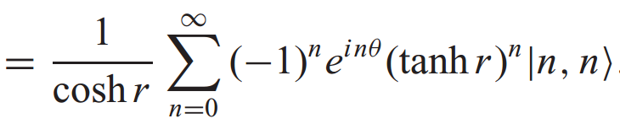
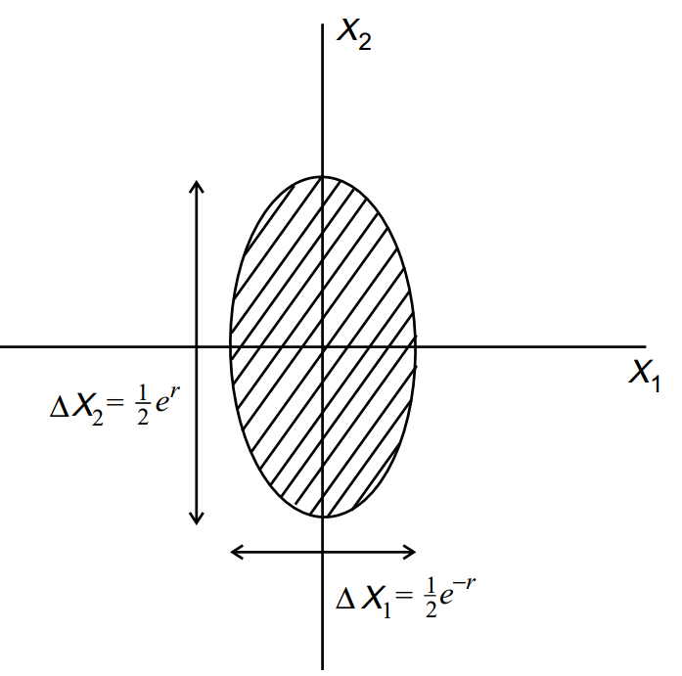
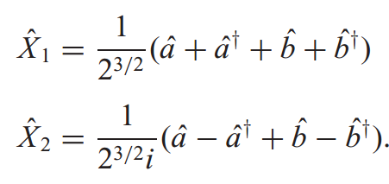

two mode squeeze operator
$$\left[{\hat{X}}_{1},{\hat{X}}_{2}\right]=i/2$$
fluctuations are reduced below the vacuum level
measurements can surpass the standard quantum limit in sensitivity.

Slide 3


squeezed vacuum reservoir
M. O. Scully, M. S. Zubairy, Quantum Optics
A two-level system interacting with the squeezed vacuum reservoir:
enhanced dephasing
suppressed dephasing
How to generate the squeezed vacuum in all directions?

Slide 4

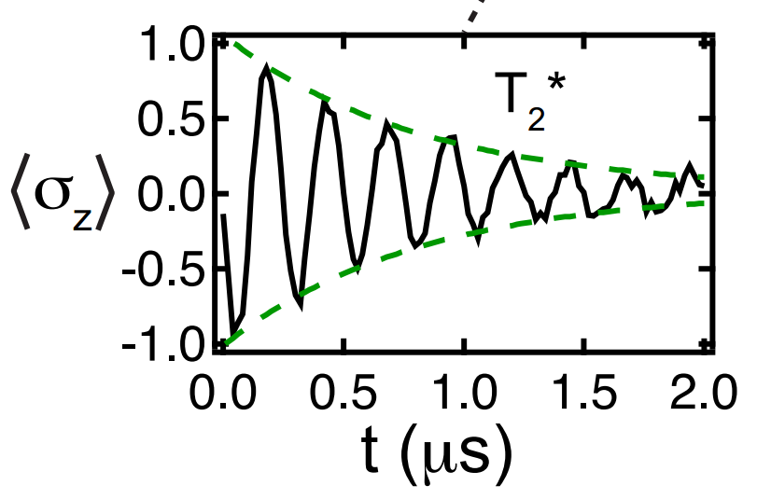
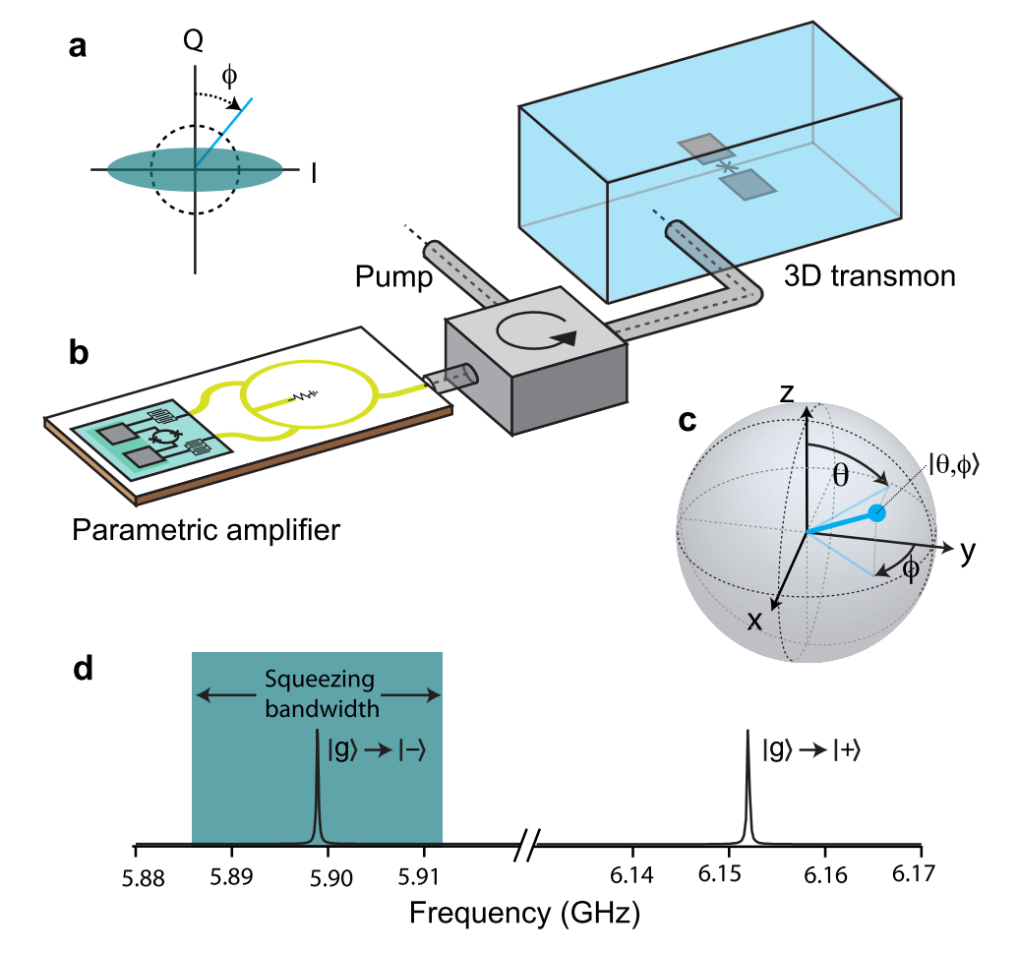
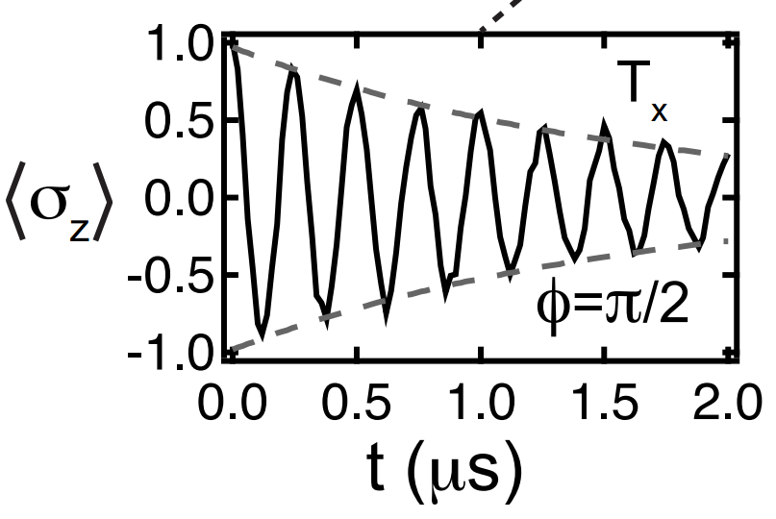
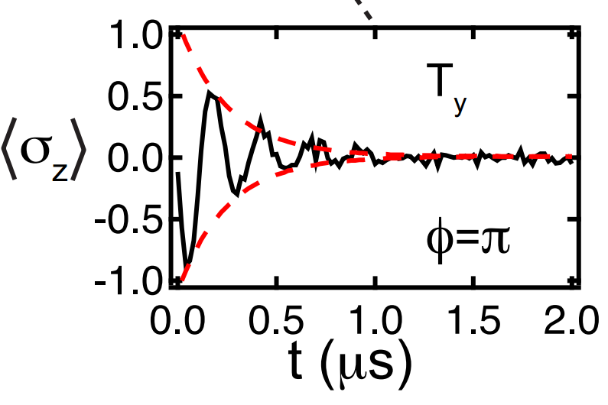
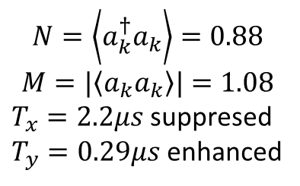
Experimental proof
squeezed vacuum reservoir
K. W. Murch et. al., Nature, 2013
$$N=\left\langle a_{k}^{†}a_{k}\right\rangle =0.88$$
$$M=|\left\langle a_{k}a_{k}\right\rangle |=1.08$$
$T_{x}=2.2μs$ suppresed
$T_{y}=0.29μs$ enhanced

Slide 5
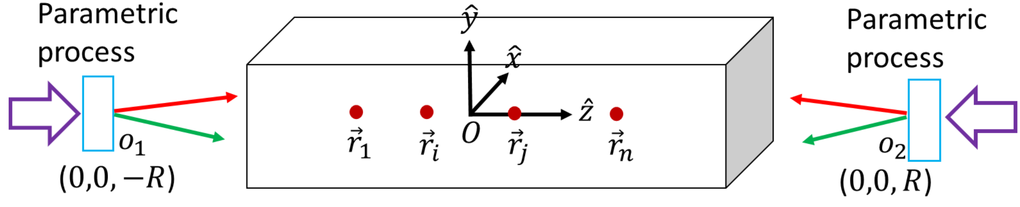
Waveguide QED

Slide 6
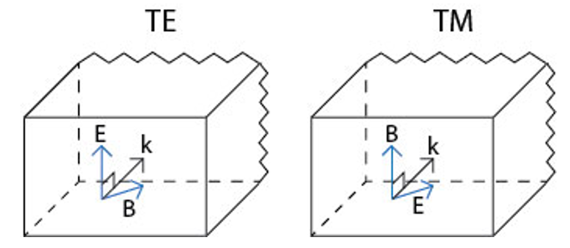
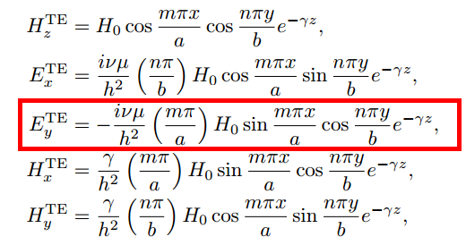
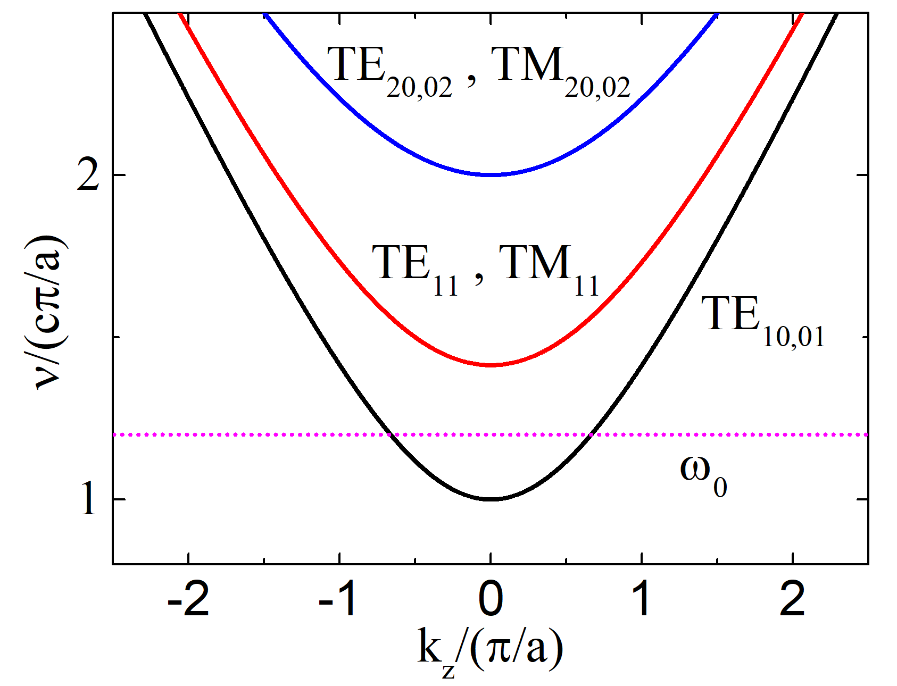
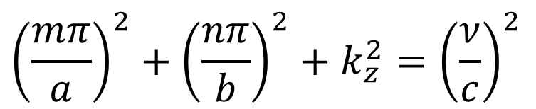


$${\left(\frac{mπ}{a}\right)}^{2}+{\left(\frac{nπ}{b}\right)}^{2}+k_{z}^{2}={\left(\frac{ν}{c}\right)}^{2}$$
$$TE_{01}(x)$$
$$TE_{10}(y)$$

Slide 7
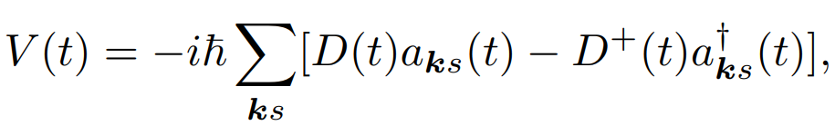
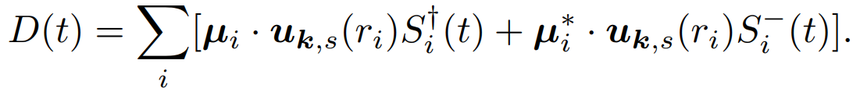
Master equation
A group of identical two level atoms located at $r_{i}$
compact version:

Slide 8
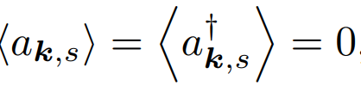
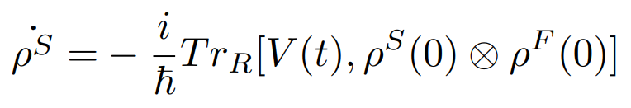
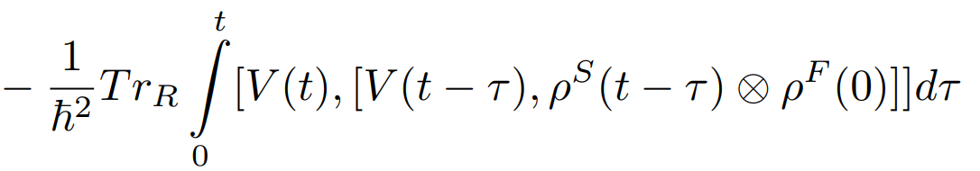
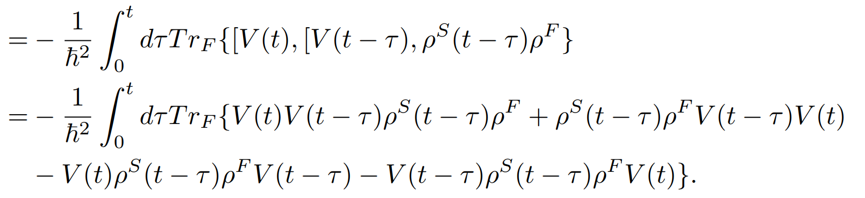
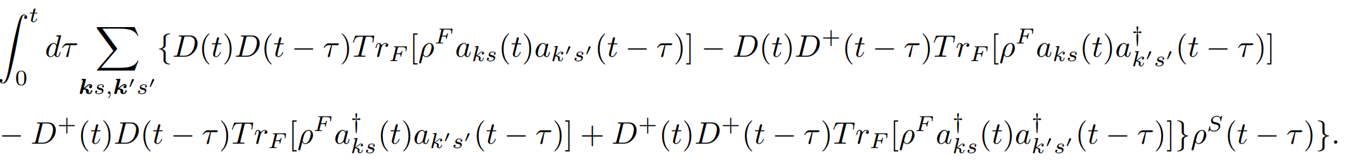
where

Slide 9
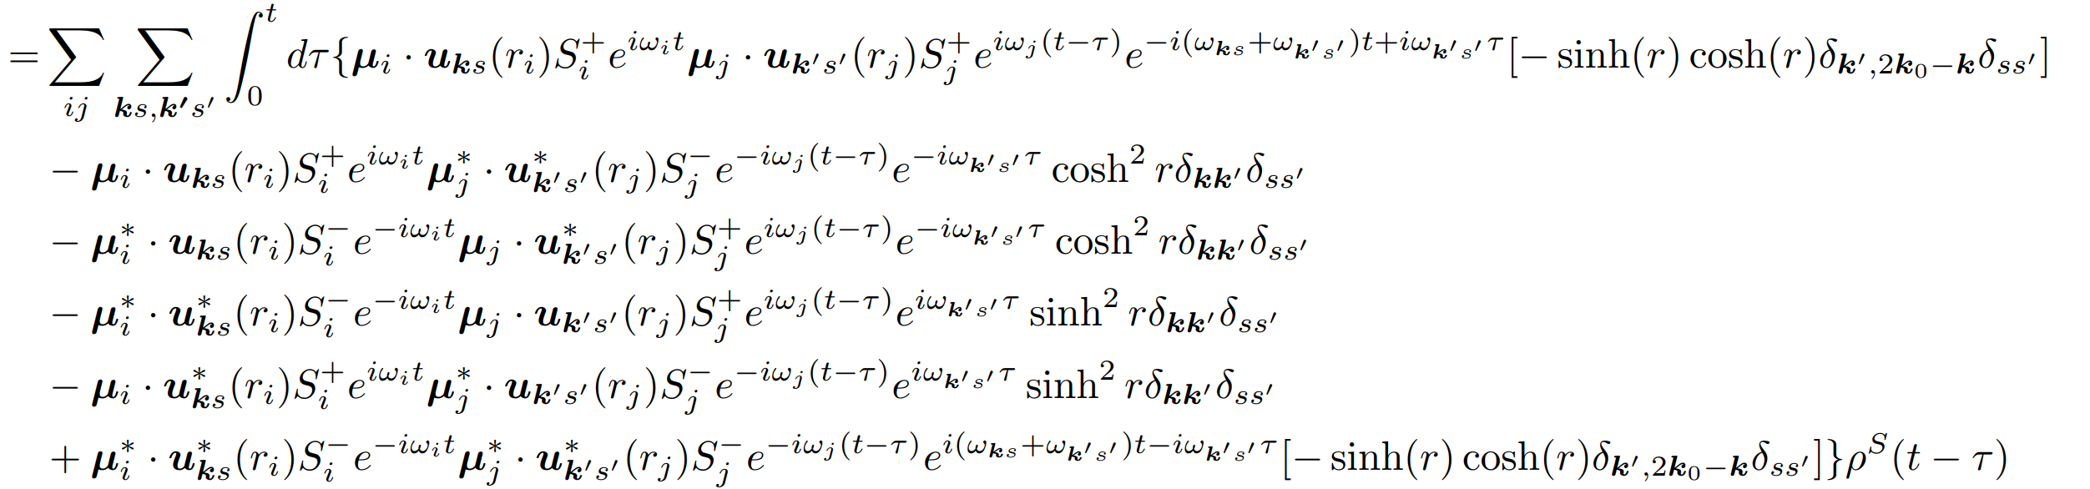

Slide 10
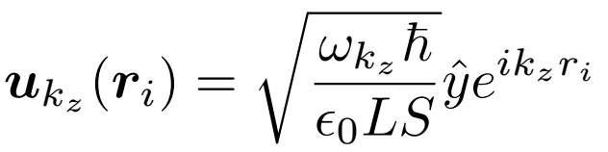
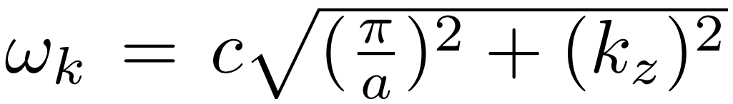
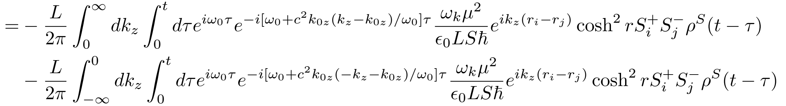

Slide 11
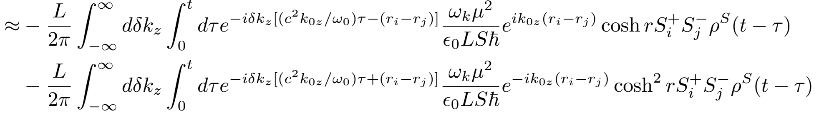
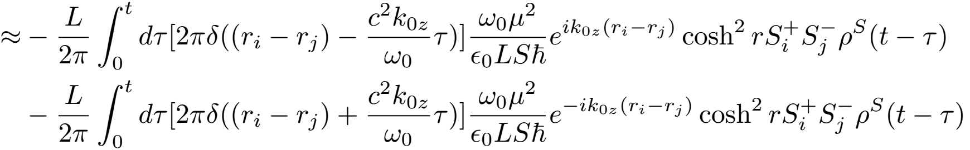

$$k_{z}=k_{0z}+δk_{z}$$
Weisskopf approximation
one is vanishing, while the other is non-vanishing

Slide 12
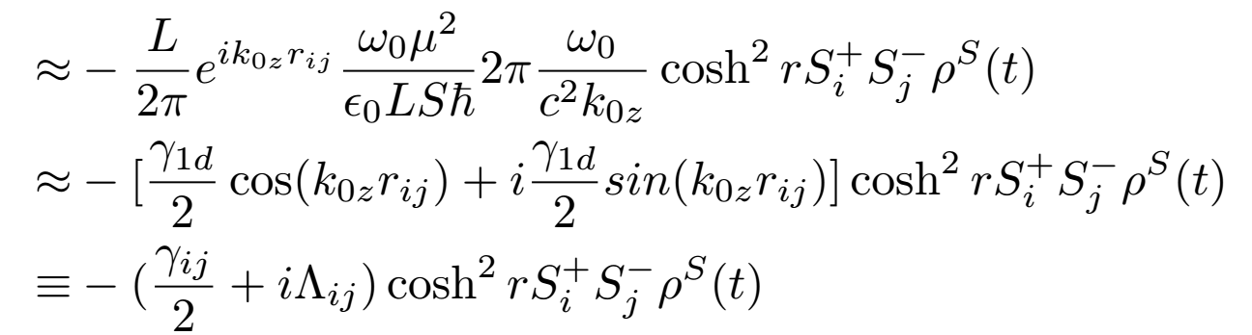


Slide 13
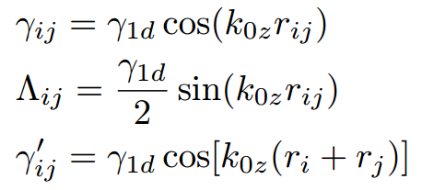
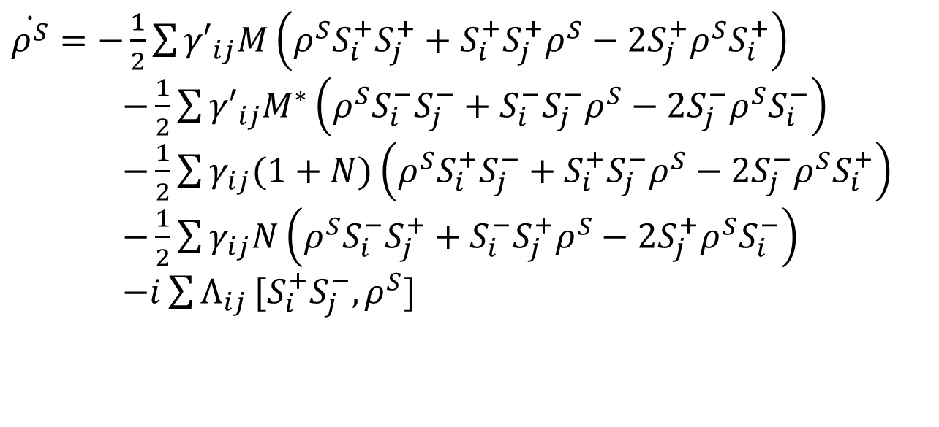


$$⟨a_{k}a_{k′}⟩$$
$\dot{ρ^{S}}=$ $−\frac{1}{2}\sum{{γ′}_{ij}M}\left(ρ^{S}S_{i}^{+}S_{j}^{+}+S_{i}^{+}S_{j}^{+}ρ^{S}−2S_{j}^{+}ρ^{S}S_{i}^{+}\right)$
$−\frac{1}{2}\sum{{γ′}_{ij}M^{∗}}\left(ρ^{S}S_{i}^{−}S_{j}^{−}+S_{i}^{−}S_{j}^{−}ρ^{S}−2S_{j}^{−}ρ^{S}S_{i}^{−}\right)$
$−\frac{1}{2}\sum{γ_{ij}(1+N)}\left(ρ^{S}S_{i}^{+}S_{j}^{−}+S_{i}^{+}S_{j}^{−}ρ^{S}−2S_{j}^{−}ρ^{S}S_{i}^{+}\right)$
$−\frac{1}{2}\sum{γ_{ij}N}\left(ρ^{S}S_{i}^{−}S_{j}^{+}+S_{i}^{−}S_{j}^{+}ρ^{S}−2S_{j}^{+}ρ^{S}S_{i}^{−}\right)$
$−i\sum{Λ_{ij}}[S_{i}^{+}S_{j}^{−},ρ^{S}]$
induced by the coherence
induced by the average photon number
energy shift
$$⟨a_{k}^{+} a_{k′}⟩$$
COM

Slide 14
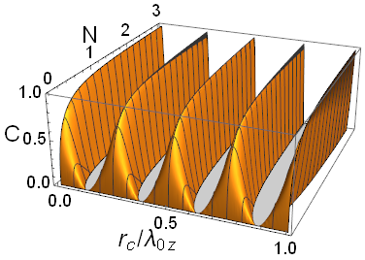
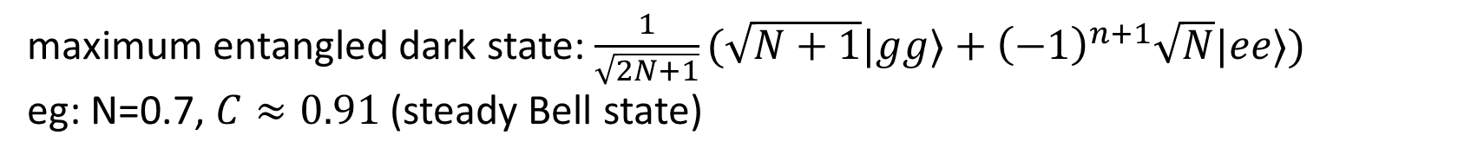




the steady state of two qubits
$$ω_{0}$$
$$ω_{0}+δω$$
$$ω_{0}−δω$$
$$ω_{0}$$
maximum entangled dark state: $\frac{1}{\sqrt{2N+1}}(\sqrt{N+1}|gg⟩+{\left(−1\right)}^{n+1}\sqrt{N}|ee⟩)$
eg: N=0.7, $C≈0.91$ (steady Bell state)

Slide 15
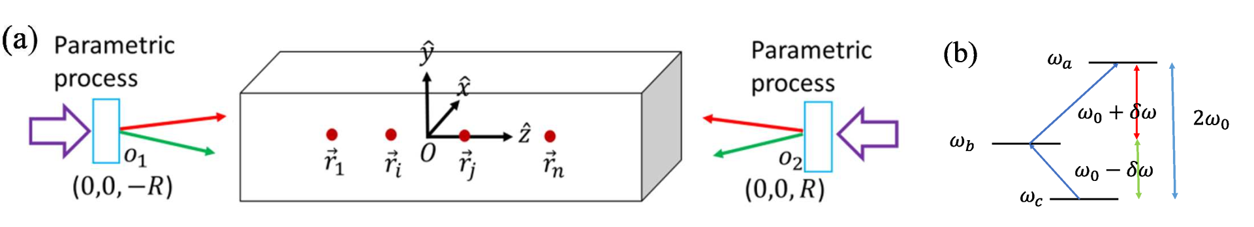






Three-level system
$$ω_{0}$$
$$ω_{bc}$$
$$ω_{ab}$$
$$δω$$
$$δω$$
$$ν$$

Slide 16
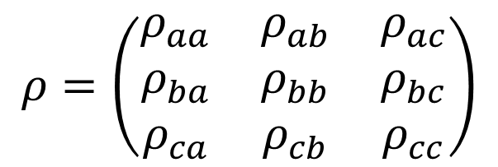
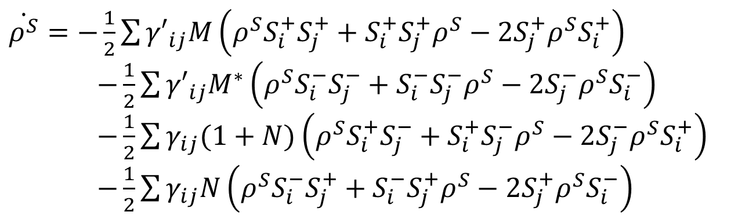



single atom
$$\cosh{r}\sinh{r}$$
$\dot{ρ^{S}}=$ $−\frac{1}{2}\sum{{γ′}_{ij}M}\left(ρ^{S}S_{i}^{+}S_{j}^{+}+S_{i}^{+}S_{j}^{+}ρ^{S}−2S_{j}^{+}ρ^{S}S_{i}^{+}\right)$
$−\frac{1}{2}\sum{{γ′}_{ij}M^{∗}}\left(ρ^{S}S_{i}^{−}S_{j}^{−}+S_{i}^{−}S_{j}^{−}ρ^{S}−2S_{j}^{−}ρ^{S}S_{i}^{−}\right)$
$−\frac{1}{2}\sum{γ_{ij}(1+N)}\left(ρ^{S}S_{i}^{+}S_{j}^{−}+S_{i}^{+}S_{j}^{−}ρ^{S}−2S_{j}^{−}ρ^{S}S_{i}^{+}\right)$
$−\frac{1}{2}\sum{γ_{ij}N}\left(ρ^{S}S_{i}^{−}S_{j}^{+}+S_{i}^{−}S_{j}^{+}ρ^{S}−2S_{j}^{+}ρ^{S}S_{i}^{−}\right)$
$$γ_{1d}$$
$$\sinh^{2}{r}$$
$$ρ=\left(\begin{matrix}ρ_{aa} & ρ_{ab} & ρ_{ac} \\ ρ_{ba} & ρ_{bb} & ρ_{bc} \\ ρ_{ca} & ρ_{cb} & ρ_{cc}\end{matrix}\right)$$

Slide 17
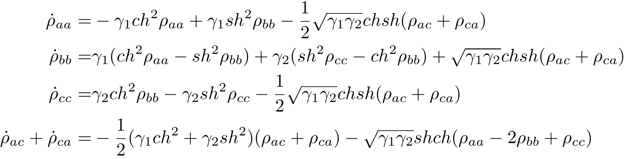
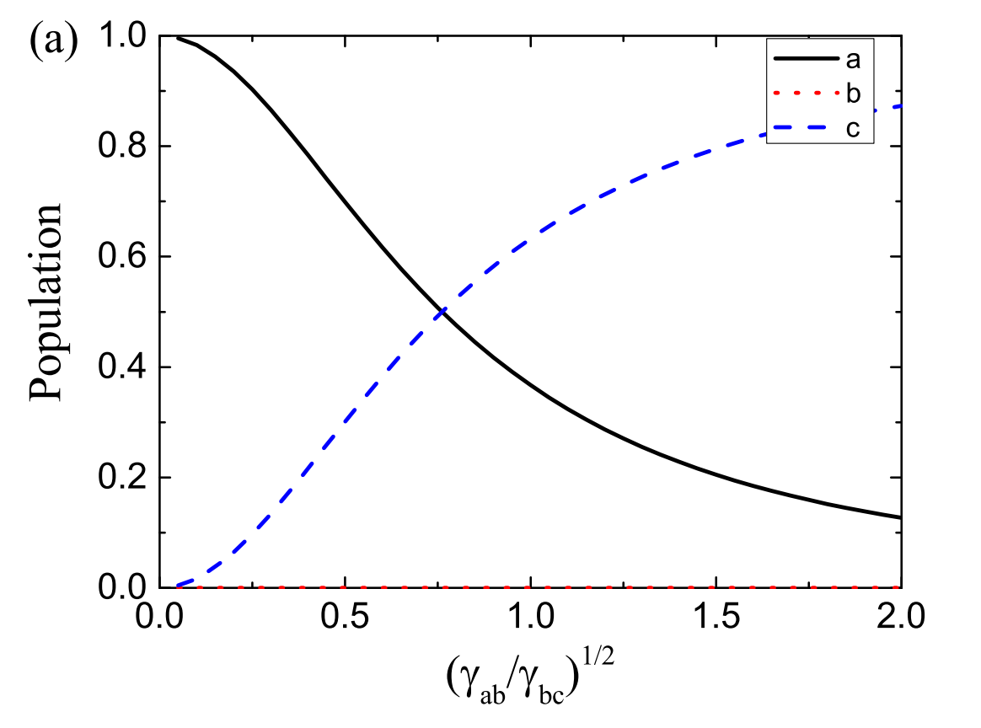
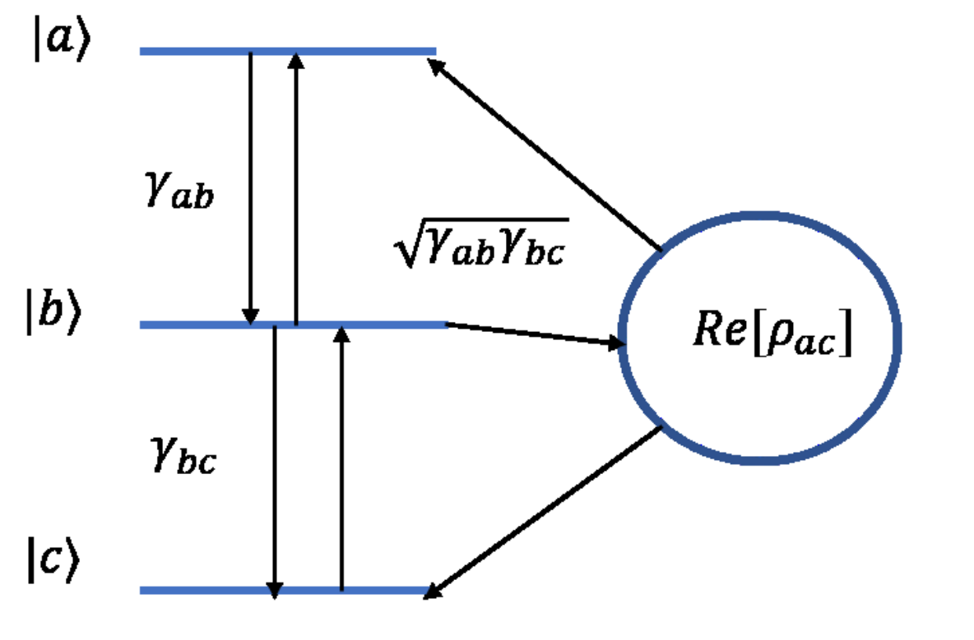

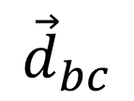
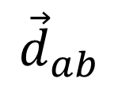
$$\vec{E}$$
$${\vec{d}}_{bc}$$
$${\vec{d}}_{ab}$$

Slide 18
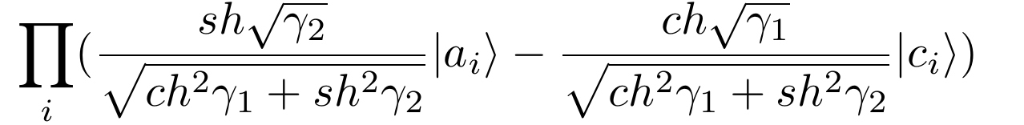
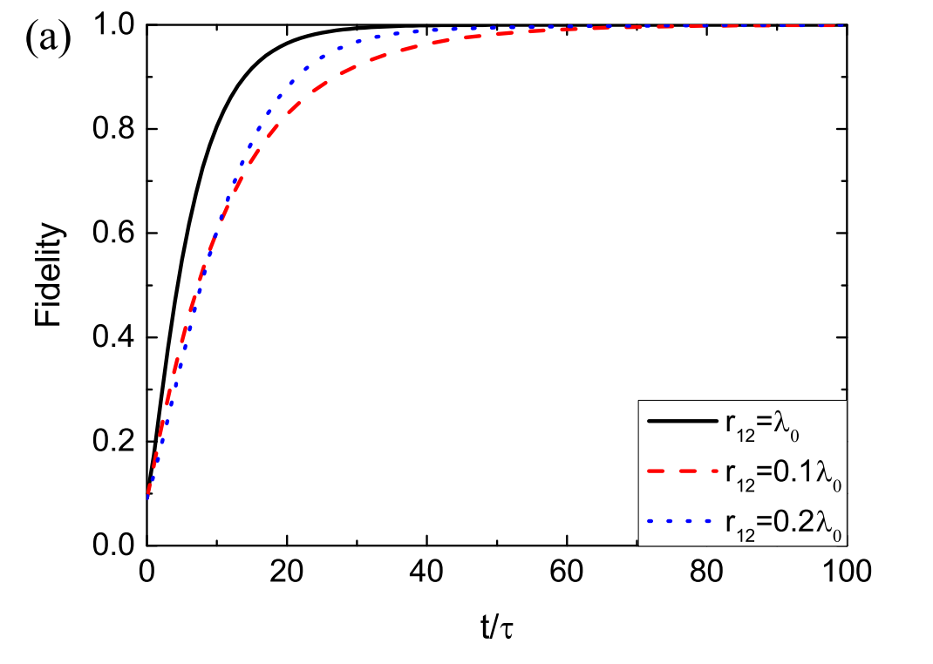
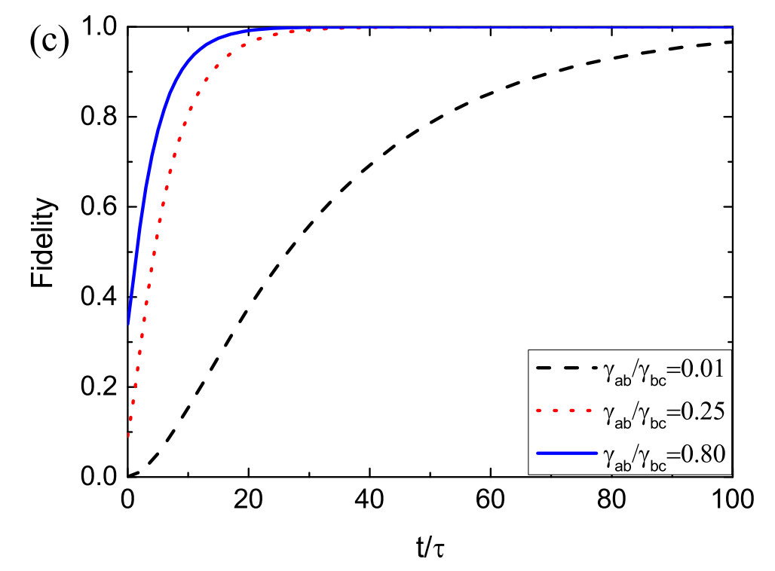
multiple three-level atoms
steady state:
100% population inversion for arbitrary number of atoms in the steady state!

